Slide 1
POLI 202: The Government of Canada
The Legislature

Slide 2
Course Outline
Parliament
The Crown
The Senate
How it works
Senate Reform
The House of Commons
MP roles
HoC highlights
How a bill becomes a law

Slide 3
Parliament
Parliament in Canada is composed of three bodies:
The Crown
The Senate
The House of Commons
This means that technically, only 1 third of Canada’s Parliament is democratically elected.
Nevertheless, it can be argued that the House of Commons is its most important component.

Slide 4
The Crown
The Crown has many roles in the legislative process, though most of them are ceremonial.
The Queen does not act directly in Canadian politics. Instead, the monarch mandates a representative to act in their name in Canada.
This representative is the Governor General.

Slide 5
The Crown
One of the most important roles of the Crown in the legislative process consists in the power of Royal Assent.
This is a public declaration that the law is legitimate.
At the end of the legislative process, the governor general must sign a bill so that the law becomes effective.

Slide 6
The Crown
In theory, the governor general could refuse to sign a law supported by the House of Commons and the Senate.
Today, the governor general will sign any law sent by the HoC and Senate. They will not use this power to influence the content of the law.

Slide 7
The Crown
At the beginning of every parliamentary session, the governor general reads the Speech from the Throne.
This sets out the government’s plans for the coming legislative session.
In practice, the Speech is written by the Prime Minister and his staff. It is only read by the governor general.

Slide 8
The Crown
The governor general plays a very important role in terms of government formation.
After every election, the governor general asks a party leader to form the government.
The governor general can also prorogue or dissolve the House when requested by the Prime Minister.
Prorogation: Ending the parliamentary session, suspending Parliament until the next one.
Dissolution: Ending the parliamentary session and triggering an election.
Theoretically, the governor general can seek to replace the government if it is defeated in the House.

Slide 9
The Crown
Questions?

Slide 10
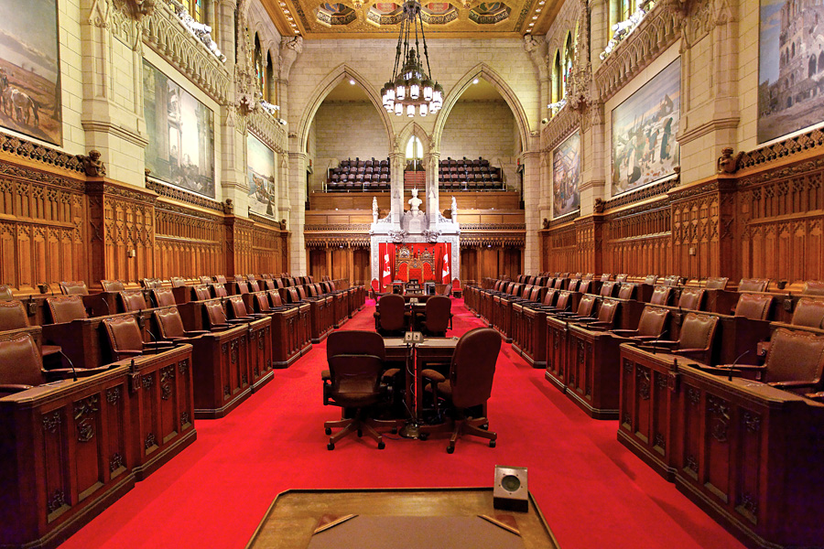
The Senate

Slide 11
The Senate
Canada’s Parliament contains two chambers.
They are the House of Commons and the Senate.
This is referred to as « bicameralism ».

Slide 12
The Senate
The members of the Senate are appointed, rather than elected.
They are appointed by the governor general, on recommendation of the Prime minister.
This is why the Senate is referred to as a Chamber of « sober, second thought ».

Slide 13
The Senate
According to the literature, the Senate plays this role fairly well.
It can conduct commissions and receive witnesses to revise important questions pertaining to bills they are studying.
Senators can also be part of Senate committees that study questions in depth with the goal of advising the government.

Slide 14
The Senate
However, the Senate rarely opposes or modifies bills from the House of Commons. (Bernard, 1995)
From 1867 to 1992, the Senate approved 99% of bills sent from the House of Commons.
95% of these were approved without any changes.

Slide 15
The Senate
This raises questions about the relevance of the Senate.
When the Senate rejects a bill from the House of Commons, it can raise questions of legitimacy. How can these appointed people thwart the will of the democratically elected representatives of the public?
If the Senate simply approves bills from the House of Commons, however, the Senate may seem irrelevant. What is the point of a Senate if it only rubberstamps what the House of Commons does?
There is no formal dispute resolution mechanism between the two bodies, so as a convention the Senate defers to the House during disagreements.

Slide 16
The Senate
The second objective of the Senate is to represent the regions of the country, instead of specific ridings.
The idea is two have 2 chambers with representatives divided according to different principles.
The House of Commons represents the people of Canada, and so follows the principle of representation by population, according to which each province and territory receive a number of seat roughly equal to their share of the country’s population.

Slide 17
The Senate
The Senate follows a principle of regional representation.
The Senate was divided in four regions with 24 seats each (West, Ontario, Quebec, Maritimes).
Upon its entry in Confederation in 1949, Newfoundland and Labrador was awarded 6 seats. (Giving 30 seats total to the Atlantic)
Each territory (Yukon, NWT, Nunavut) has one seat as well.
There are 105 seats in the Canada Senate.

Slide 18
The Senate
In practice, the Senate does not really play the role of representing regions.
Since the senators are named by the federal Prime Minister, it is unclear why they would be good representatives of their region.

Slide 19
The Senate
Requirements to become a senator
Be a Canadian citizen
Own land in the region you represent
Be 30 years of age or older
Be appointed by the governor general on recommendation of the PM.
You are then a Senator until the age of 75.

Slide 20
The Senate
Reforming the Senate is extremely difficult.
This is because the Senate is part of the Canadian Constitution, and modifying the Constitution is extremely difficult.
As a result, only minor reforms have been enacted recently.

Slide 21
The Senate
Since senators are supposed to represent regions of the country, one could expect that regions would choose their own senators.
Some suggest that each region could hold elections to select their senators. (Alberta)
Others suggest that premiers should be able to appoint the senators representing their region, instead of the federal PM. (Quebec)

Slide 22
The Senate
Recent reforms to the way the Senate works have been enacted by PM Justin Trudeau.
He has expelled Liberal senators from the Liberal caucus, meaning that they do not attend the same meeting as the Liberal MPs.
This was done to encourage independence of the senators named by Liberal governments.

Slide 23
The Senate
However, these senators decided to still call themselves Liberals, and meet in the new Senate Liberal caucus.
Since then, Senators have created a new organization called the Independent Senators Group.
This organization is more distant from the Liberal party and now includes former Conservatives.

Slide 24
The Senate
The Trudeau Liberals also changed the process of senator appointment.
Instead of being appointed by the Prime minister, a committee studies applications by Canadians interested to become senators.
This committee then makes recommendations to the Prime minister, who then appoints the Senator.
These recommendations, however, are neither public nor binding.

Slide 25
The Senate
A commonly requested reform of the Senate calls for a triple-E Senate.
This senate would be equal, elected, and effective.
An elected senate would be elected by a vote in the region or province that senators are supposed to represent. Proponents argue that this would give greater legitimacy to the Senate.

Slide 26
The Senate
An equal Senate would have the same number of senators for each province.
The reasoning behind this is that while the House of Commons represents the people, the Senate should represent the provinces, and they should all have the same weight.

Slide 27
The Senate
This is especially favoured in small provinces, because it would reduce the weight of Ontario and Quebec (24 senators each currently).
The West is especially favourable to this change.
Right now, British Columbia and Alberta have 6 seats each, while New-Brunswick and Nova Scotia have 10 seats each.

Slide 28
The Senate
Finally, the Senate should be more effective. Arguably, simply by being elected, senators would get more legitimacy.
However, this could cause deadlock in Parliament. Today, when there is a conflict between the House and the Senate, it is expected that the Senate will yield since they are unelected.

Slide 29
The Senate
Others recommend the outright abolition of the Senate.
They claim that it is not needed.
Doing so would also save 100M$/year (KPMG estimate, 2014)

Slide 30
The Senate
Questions?

Slide 31
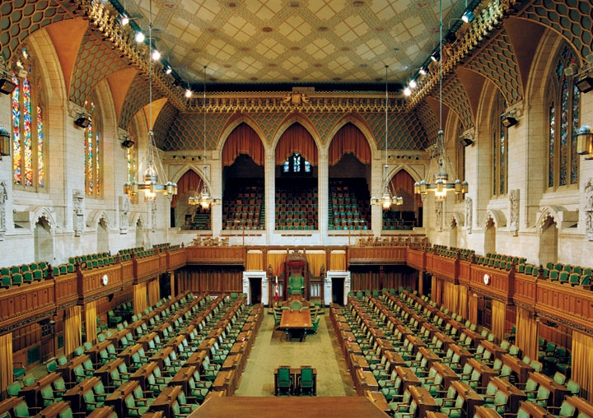
The House of Commons

Slide 32
The House of Commons
A key question in designing institutions consists of identifying the interdependence between the executive and legislative aspects of government.
This separation is clear in the United States.
The U.S. clearly differentiates between Congress (legislative), the White House (executive) and the Supreme Court (judicial).

Slide 33
The House of Commons
In a parliamentary system (like Canada’s), this is not the case.
On the contrary, most members of the government (the executive) sit in the House of Commons (the legislative).
While this may raise questions about checks and balances, it gives an opportunity to opposition MPs to hold members of the government to account.
One example of this is Question Period, where MPs can ask ministers to inform the House of the situation of the government.

Slide 34
Convergence of Executive and Legislative
Cabinet members enjoy some privileges over the members of Parliament who are not members of Cabinet.
Greater influence in the policy process
Introduce legislation that raises or spends public money
Longer and more successful careers
Better compensation (salary, drivers, limo, etc.)
Notes:
Details in future slides.

Slide 35
Convergence of Executive and Legislative
While all MPs can introduce legislation, Cabinet MPs will introduce legislation on behalf of the government.
This means they will introduce most legislation the House will consider, and their legislation is the most likely to be adopted.
Having a seat in Cabinet means they can participate in conversations regarding the orientation of the government, which grants them greater influence.

Slide 36
Convergence of Executive and Legislative
Bills that raise or spend public money are in a specific category. This is because the government is responsible for managing money given to it by citizens to fund public services.
Only the government can introduce such bills.
Opposition cannot introduce new budget, new taxes, etc.
Such measures cannot be introduced in the Senate either.

Slide 37
Convergence of Executive and Legislative
Cabinet members typically have longer and more succesful careers than other MPs. (Atkinson and Docherty, 1992)
This is because their role gives them greater stature in the media, which boosts their personal notoriety among voters.
They can also use their influence to benefit their riding, and their constituents may in turn reward them for these benefits.

Slide 38
Important Roles in the House of Commons
The Speaker is the person in charge of presiding over the House of Commons.
The Speaker makes sure that everybody can speak when it is their turn.
The Speaker also enforces the rules of Parliament.
Elected by the MPs, the Speaker is typically from the rank of the governing party (because they have the most votes).

Slide 39
Important Roles in the House of Commons
The Speaker should appear as neutral as possible, despite being elected under a party’s banner.
For this reason, the Speaker is excused from party business and caucus meetings.
The Speaker does not participate in partisan action (like fundraising or campaigning).
Does not vote, unless there is a tie, in which case they vote with the government.

Slide 40
Important Roles in the House of Commons
Opposition leaders are the leader of the parties that do not form the government.
They have many privileges.
They speak first during question period.
They nominate members of their party to act as critics for specific portfolios, who will be tasked to hold corresponding ministers accountable.

Slide 41
Important Roles in the House of Commons
House leaders sit next to the party leaders (not the same person).
Their role is to make sure that parliamentary rules are respected.
If they believe a rule has been broken, they may address the President to ask him to consider whether this has been the case.
They are responsible for making sure that parliamentary activities run smoothly and efficiently.

Slide 42
Important Roles in the House of Commons
The whip is also an important role in a parliamentary group.
Whips are responsible for internal discipline within the party.
They make sure that MPs show up to the House of Commons and that they vote the « right » way.

Slide 43
Important Roles in the House of Commons
Questions?

Slide 44
HoC: The Highlights
Question Period
MP Affairs
Government Affairs
Caucus meetings

Slide 45
Question Period
During Question Period, opposition MPs do their best to hold government to account.
This involves asking them difficult questions about how they manage the country, when they will introduce important legislation, how they will deal with an important issue, etc.
Questions can also focus on scandals and personal conduct of the minister.
Ministers are not given the question ahead of time. This means that they may not be prepared to answer this question.

Slide 46
Question Period
The Speaker of the House gives the first question to the leader of the official opposition.
This person can ask one question, with two follow-ups.
Then the leader of the second opposition party does the same, until all recognized parties have done so.
After this, MPs can ask questions, including government MPs.

Slide 47
Question Period
The government can choose which minister will answer the question.
So even if the MP wants the Prime Minister to answer the question, another minister might answer instead.
This rule can be used by government ministers to dodge questions.
Can also be used to be absent from the House.

Slide 48
Question Period
A characteristic unique to Question Period in Canada is the « scrum ».
After Question Period, journalists can ask questions of Cabinet ministers and MPs in a very informal way.
This gives them an opportunity to advance their agenda and communicate with the public.
This creates strong incentives for parliamentarians to shine in Question Period.
They know they are filmed during Question Period, and then may be interviewed right after.

Slide 49
MP Affairs
Individual MPs introduce motions and bills.
The order in which this is done is determined randomly at the beginning of each parliamentary session.
Sometimes, parties will use their member’s turn to advance the interest of the party instead.
The MP loses the opportunity to speak about their own priorities, but they can gain a national profile and the gratitude of their party.

Slide 50
Governmental Affairs
This takes the lion’s share of the time in the House of Commons.
This is where bills introduced by the government are discussed, debated, and amended.
This can include the budget or the speech from the throne.
Which bills are submitted and in which order is determined by the House leader of the governing party.

Slide 51
Caucus meetings
A caucus is where party members meet with fellow members of their own party.
They play a very different role for the government party and the opposition.
For the opposition, such meetings are mostly about strategy.
They decide what they will focus on during Question period, decide policy stance on legislation, and generally how to oppose the government.

Slide 52
Caucus meetings
This is different for governmental parties.
Governmental parties have two types of members: ministers and MPs.
MPs use caucus meetings to tell the Cabinet members about the views of their constituents.
The government may announce new legislation to the caucus, and the MPs may try to change this legislation before it becomes public.
The government may also try its messaging with MPs, and decide to refine it if it does not appear to work.

Slide 53
Caucus meetings
Questions?

Slide 54
How a bill becomes a law
Most bills come from the Cabinet.
They are developed in a committee accountable to the Cabinet
The committee is chaired by a minister, and can include whoever they (and the PM) want.
This committee comes up with a fleshed out proposal, which is submitted to the Cabinet.

Slide 55
How a bill becomes a law
If the Cabinet approves it, then the Ministry of Justice will write the official bill in both official languages.
It makes sure that one minister will sponsor it in the House of Commons.
It also makes sure that it is compliant with the Charter of Rights and Freedoms.
The Ministry of Justice returns the bill to Cabinet for approval.
When these steps are completed, then the government House leader will schedule the bill during Parliamentary affairs.

Slide 56
How a bill becomes a law
48 hours later, the bill can be announced in the House. This gives time to other parties to prepare.
There are three votes (referred to as « readings ») before a bill becomes a law.
First reading: The House states that the bill is receivable according to the rules.
The bill then becomes public.

Slide 57
How a bill becomes a law
Second reading
At this stage, MPs vote on the general principle behind the bill.
This gives an opportunity for opposition MPs to state their opinion on the bill during debate.
At this stage, the vote only concerns the general principle and objective of the bill, but not the details.

Slide 58
How a bill becomes a law
If the second reading passes, committees are constituted by representatives of the parties in the House of Commons in proportion of their seats.
If the governmental party has most of the seats in the HoC, it will have most of the seats in committee as well.
The committee is supposed to study bills in great detail.
Committees can summon witnesses and request documents necessary for its work.

Slide 59
How a bill becomes a law
MPs can suggest amendments, which can be either adopted or rejected in committee.
The committee will also write a report informing other MPs of what happened in committee.
After this step, there is a third reading of the bill.
If it passes, the debate ends in the House of Commons, and the bill is sent to the Senate and the governor general for Royal Assent.
The Senate follows the same procedure as the House of Commons (3 readings, committee, etc.).

Slide 60
How a bill becomes a law
Questions?

